Slide 1
Lecture 04: Assembly Language Programming (1)

Slide 2
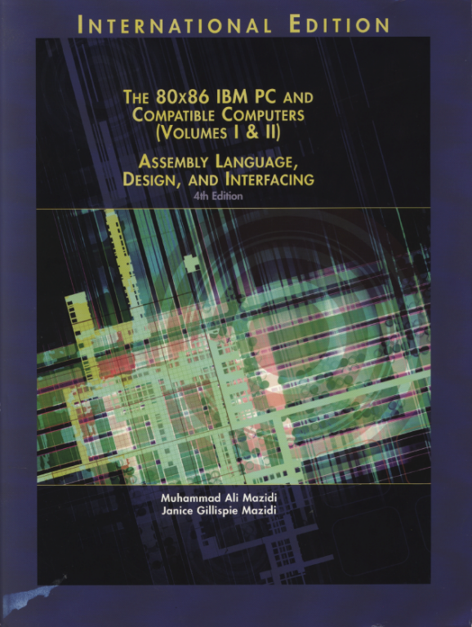
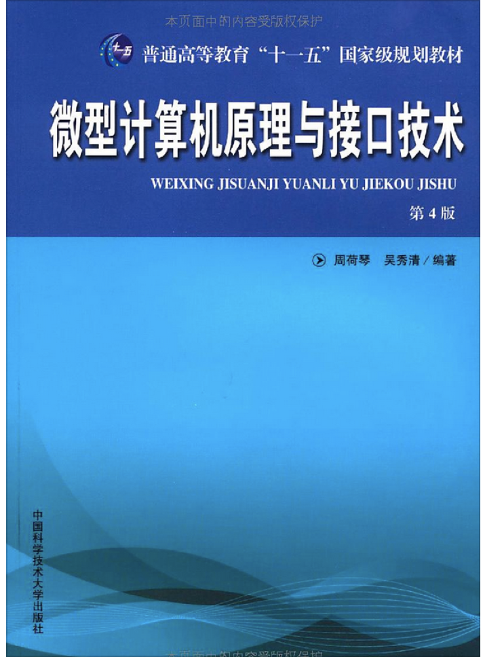
Reference Book:
The 80x86 IBM PC and Compatible Computers
Chapter 2 Assembly Language Programming
微型计算机原理与接口技术（第四版）
第3章 8086的寻址方式和指令系统
第4章 汇编语言程序设计

Slide 3
Programming Languages
Machine language
Binary code, for CPU but not human beings
Assembly language
Mnemonics for machine code instructions
Low-level language: deals with the internal structure of a CPU
Hard to program, poor portability but very efficient
BASIC, Pascal, C, Fortran, Perl, TCL, Python, …
High-level languages: do not have to be concerned with the internal details of a CPU
Easy to program, good portability but less efficient
How to convert your program in low/high-level languages into machine language?

Slide 4
Assembly Language Programs
A series of statements
Assembly language instructions
Perform the real work of the program
Directives (pseudo-instructions)
Give instructions for the assembler program about how to translate the program into machine code.
Consists of multiple segments
But CPU can access only one data segment, one code segment, one stack segment and one extra segment (Why? )

Slide 5
Form of an statement
[label:] mnemonic [operands] [;comment]
label is a reference to this statement
Rules for names: each label must be unique; letters, 0-9, (?), (.), (@), (_), and ($); first character cannot be a digit; less than 31 characters
“:” is needed if it is an instruction otherwise omitted
“;” leads a comment, the assembler omits anything on this line following a semicolon

Slide 6
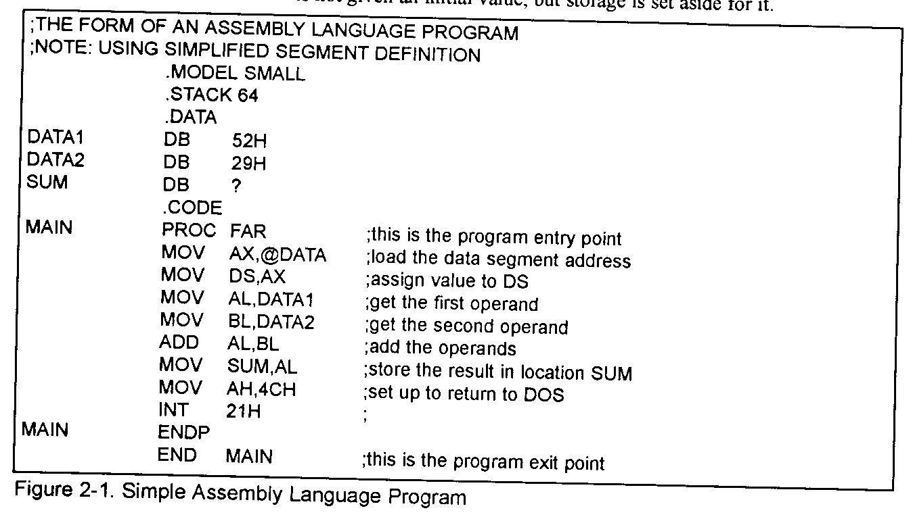
Shell of a Real Program
Full segment definition (old fashion)
See an example later
Simplified segment definition

Slide 7
Model Definition
The MODEL directive
Selects the size of the memory model
SMALL: code <=64KB, data <=64KB
MEDIUM: data <=64KB, code >64KB
COMPACT: code<=64KB, data >64KB
LARGE: data>64KB but single set of data<64KB, code>64KB
HUGE: data>64KB, code>64KB
TINY: code + data<64KB

Slide 8
Simplified Segment Definition
Simplified segment definition
.CODE, .DATA, .STACK
Only three segments can be defined
Automatically correspond to the CPU’s CS, DS, SS
DOS determines the CS and SS segment registers automatically. DS (and ES) has to be manually specified.

Slide 9
Segments All at a Glance
Stack segment
Data segment
Data definition
Code segment
Write your statements
Procedures definition
label PROC [FAR|NEAR]
label ENDP
Entrance proc should be FAR

Slide 10
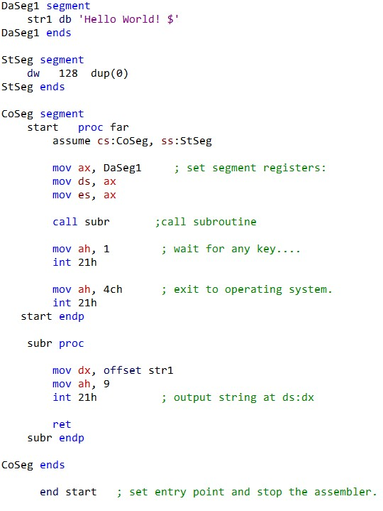
Full Segment Definition
Full segment definition
label SEGMENT
label ENDS
You name those labels
as many as needed
DOS assigns CS, SS
Program assigns DS (manually load data segments) and ES

Slide 11
Program Execution
Program starts from the entrance
Ends whenever calls 21H interruption with AH = 4CH
Procedure caller and callee
CALL procedure
RET

Slide 12
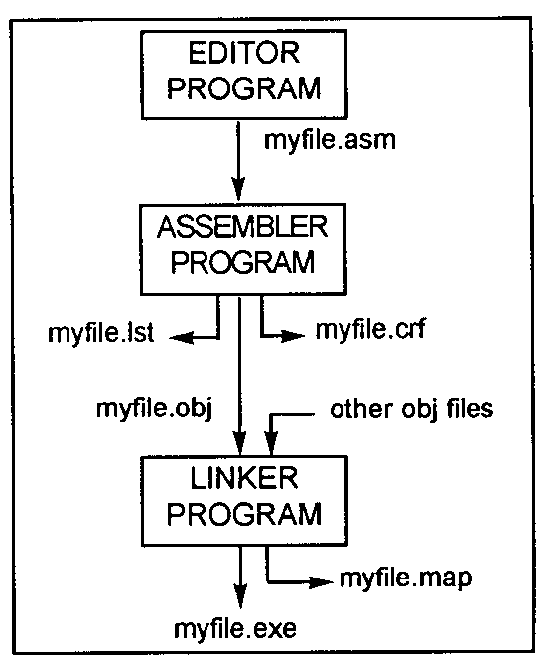


Build up Your Program

Slide 13
Control Transfer Instructions
Range
SHORT, intrasegment
IP changed: one-byte range (-128~127)
Near, intrasegment
IP changed: two-bytes range (-32768~32767)
If control is transferred within the same code segment
FAR, intersegment
CS and IP all changed
If control is transferred outside the current code segment
Jumps
CALL statement

Slide 14
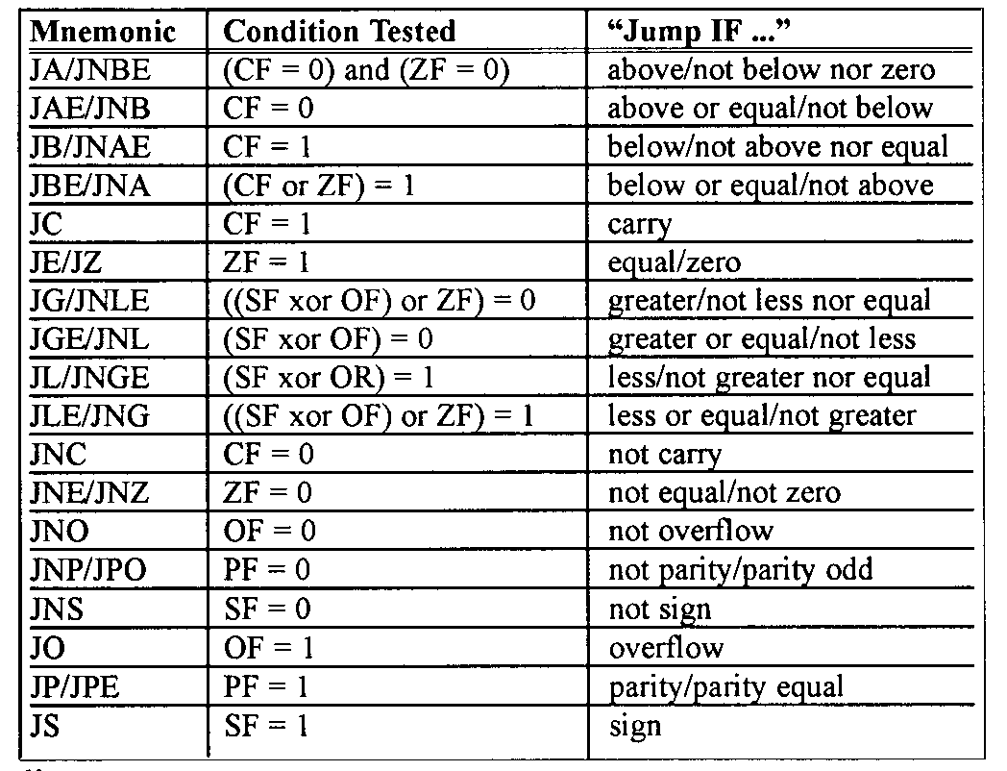
Conditional Jumps
Jump according to the value of the flag register
Short jumps

Slide 15
Unconditional Jumps
JMP [SHORT|NEAR|FAR PTR] label
Near by default

Slide 16
Subroutines & CALL Statement
Range
NEAR: procedure is defined within the same code segment with the caller
FAR: procedure is defined outside the current code segment of the caller
PROC & ENDP are used to define a subroutine
CALL is used to call a subroutine
RET is put at the end of a subroutine
Difference between a far and a near call?

Slide 17
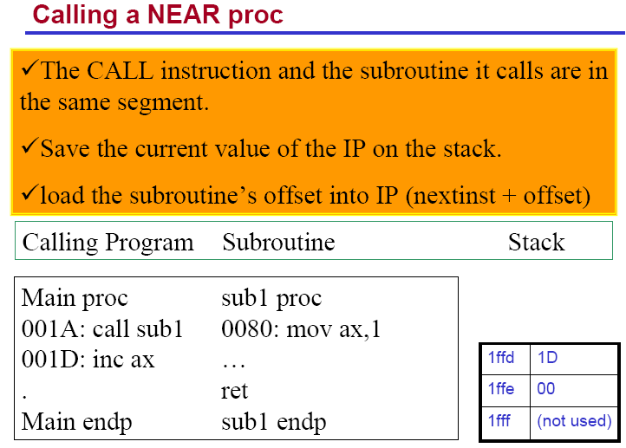

Slide 18
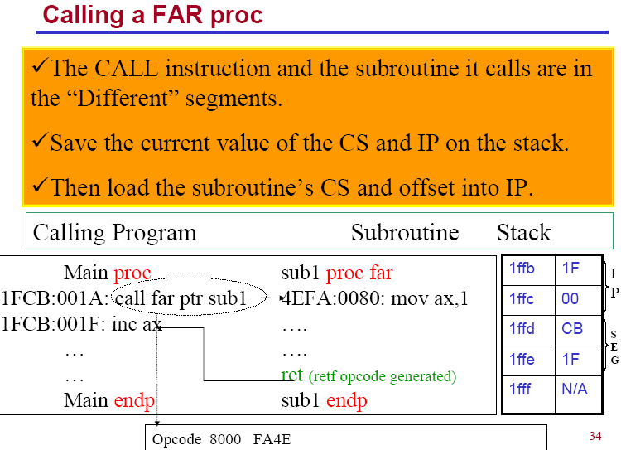

Slide 19
Data Types & Definition
CPU can process either 8-bit or 16 bit ops
What if your data is bigger?
Directives
ORG: indicates the beginning of the offset address
E.g., ORG 10H
Define variables:
DB: allocate byte-size chunks
E.g., x DB 12 | y DB 23H,48H | Z DB ‘Good Morning!’ | str DB “I’m good!”
DW, DD, DQ
EQU: define a constant
E.g., NUM EQU 234
DUP: duplicate a given number of characters
E.g., x DB 6 DUP(23H) | y DW 3 DUP(0FF10H)

Slide 20
More about Variables
For variables, they may have names
E.g., luckyNum DB 27H, time DW 0FFFFH
Variable names have three attributes:
Segment value
Offset address
Type: how a variable can be accessed (e.g., DB is byte-wise, DW is word-wise)
Get the segment value of a variable
Use SEG directive (E.g., MOV AX, SEG luchyNum)
Get the offset address of a variable
Use OFFSET directive, or LEA instruction
E.g., MOV AX, OFFSET time, or LEA AX, time
Logical address

Slide 21
More about Labels
Label definition:
Implicitly:
E.g., AGAIN: ADD AX, 03423H
Use LABEL directive:
E.g., AGAIN LABEL FAR
ADD AX, 03423H
Labels have three attributes:
Segment value:
Offset address:
Type: range for jumps, NEAR, FAR
Logical address

Slide 22
More about the PTR Directive
Temporarily change the type (range) attribute of a variable (label)
To guarantee that both operands in an instruction match
To guarantee that the jump can reach a label
E.g., DATA1 DB 10H,20H,30H ;
DATA2 DW 4023H,0A845H
……
MOV BX, WORD PTR DATA1 ; 2010H -> BX
MOV AL, BYTE PTR DATA2 ; 23H -> AL
MOV WORD PTR [BX], 10H ; [BX],[BX+1]←0010H
E.g., JMP FAR PTR aLabel

Slide 23
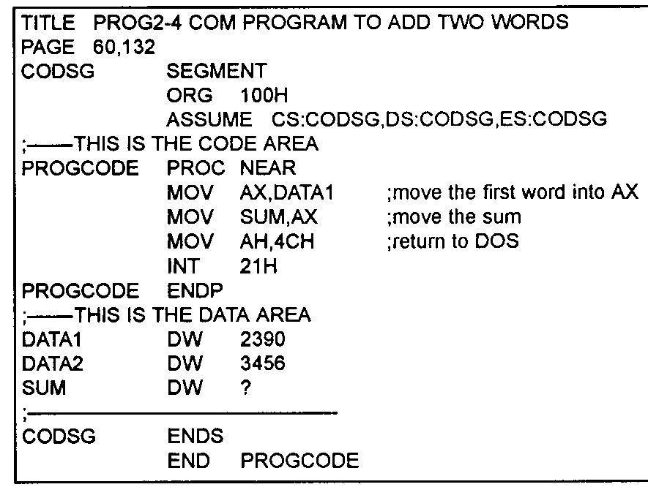
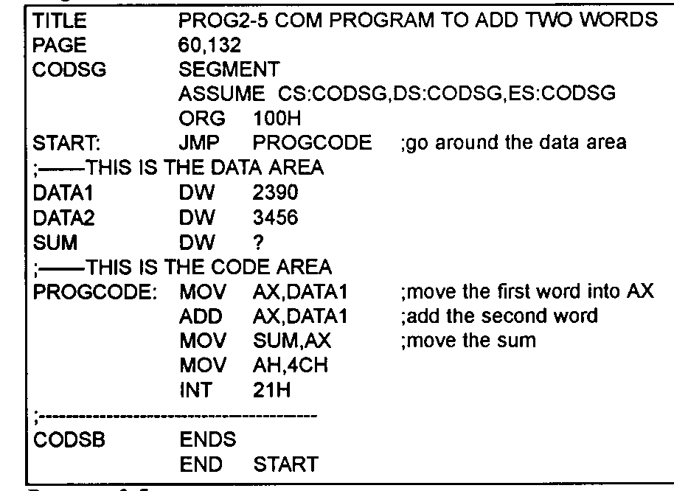
.COM Executable
One segment in total
Put data and code all together
Less than 64KB

